Slide 1
Concepts of Database Management
Sixth Edition
Chapter 4
The Relational Model 3: Advanced Topics

Slide 2
Objectives
Define, describe, and use views
Use indexes to improve database performance
Examine the security features of a DBMS
Discuss entity, referential, and legal-values integrity
Concepts of Database Management

Slide 3
Objectives (continued)
Make changes to the structure of a relational database
Define and use the system catalog
Discuss stored procedures and triggers
Concepts of Database Management

Slide 4
Views
View: application program’s or individual user’s picture of the database
Less involved than full database
Simplification
Security
Concepts of Database Management

Slide 5
Views (continued)
Defining query: SELECT command that creates a view
  Indicates what to include in the view
Query acts as a window into the database
Does not produce a new table
Query that involves a view
  DBMS does not execute the query in this form
  Query actually executed is created by merging this query with the query that defines the view
Concepts of Database Management

Slide 6
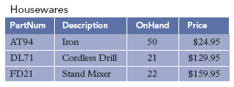
Views (continued)
  CREATE VIEW Housewares AS
  SELECT PartNum, Description, OnHand, Price
  FROM Part
  WHERE Class='HW'
  ;
FIGURE 4-1: Housewares view
Concepts of Database Management

Slide 7
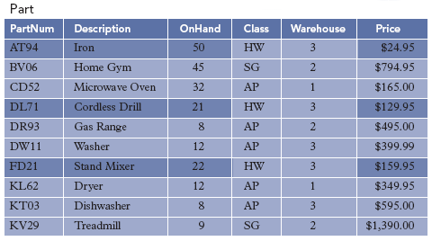
Views (continued)
FIGURE 4-2: Housewares view of the Premiere Products database
Concepts of Database Management

Slide 8
Views (continued)
To create a view in Access, create and save a query
Changing field names in a view
  SQL: include the new field names in the CREATE VIEW command
  Access: precede the name of the field with the desired name, followed by a colon
Row-and-column subset view
  Subset of rows and columns in an individual table
Concepts of Database Management

Slide 9
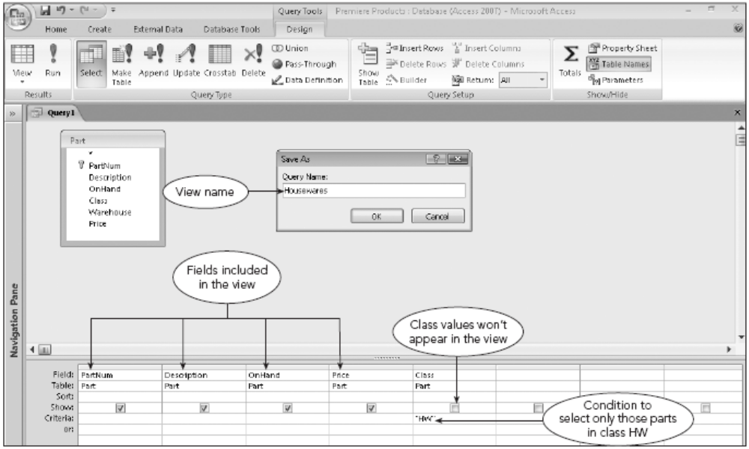
Views (continued)
FIGURE 4-3: Access query design of the Housewares view
Concepts of Database Management

Slide 10
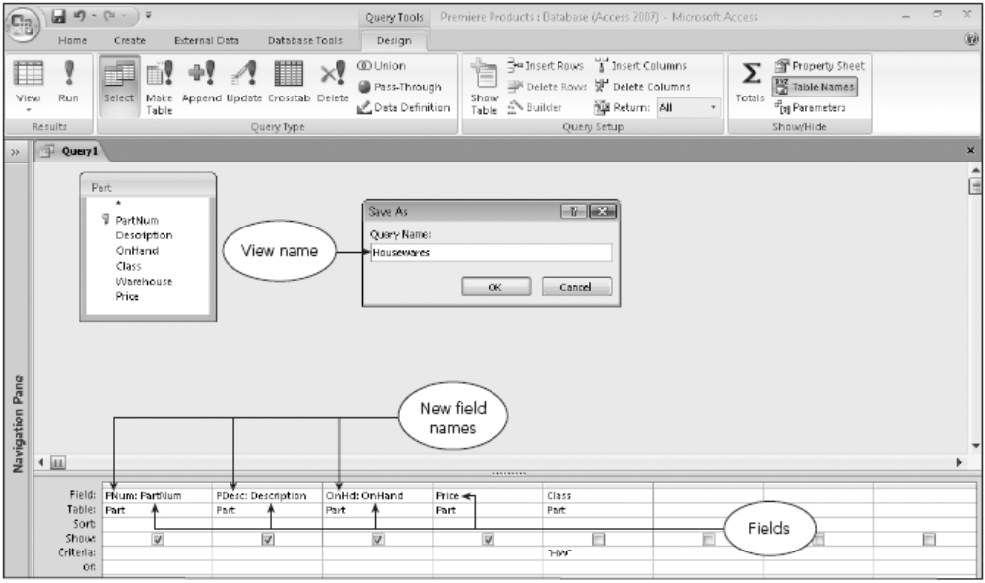
Views (continued)
FIGURE 4-5: Access query design of the Housewares view with changed field names
Concepts of Database Management

Slide 11
Views (continued)
A view can join two or more tables
Advantages of views
  Data independence
  Each user has his or her own view
  View should contain only fields required by the user
    Greatly simplifies user’s perception of database
    Security
Concepts of Database Management

Slide 12
Indexes
Conceptually similar to book index
Increase data retrieval efficiency
Record numbers automatically assigned and used by DBMS
Index key: field or combination of fields on which index is built
Advantages
  Makes some data retrieval more efficient
Concepts of Database Management

Slide 13
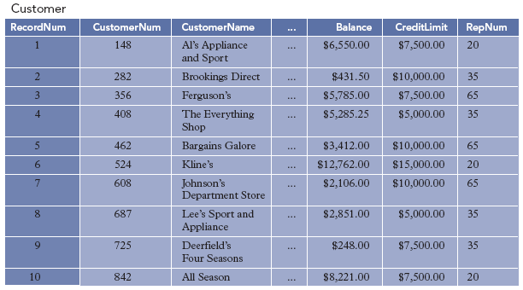
Indexes (continued)
FIGURE 4-10: Customer table with record numbers
Concepts of Database Management

Slide 14
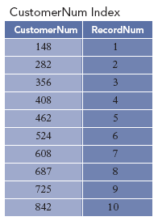
Indexes (continued)
FIGURE 4-11: Index for the Customer table on the CustomerNum field
Concepts of Database Management

Slide 15
Indexes (continued)
Disadvantages
  Occupies space on disk
  DBMS must update index whenever corresponding data are updated
Create an index on a field (or fields) when:
  Field is the primary key of the table
  Field is the foreign key in a relationship
  Field will be frequently used as a sort field
  Need to frequently locate a record based on a value in this field
Concepts of Database Management

Slide 16
Indexes (continued)
SQL command to create an index:
  CREATE INDEX CustomerName
  ON Customer (CustomerName)
  ;
Single-field index
  Key is a single field
  Also called a single-column index
Multiple-field index
  More than one key field
  Also called a multiple-column index
Concepts of Database Management

Slide 17
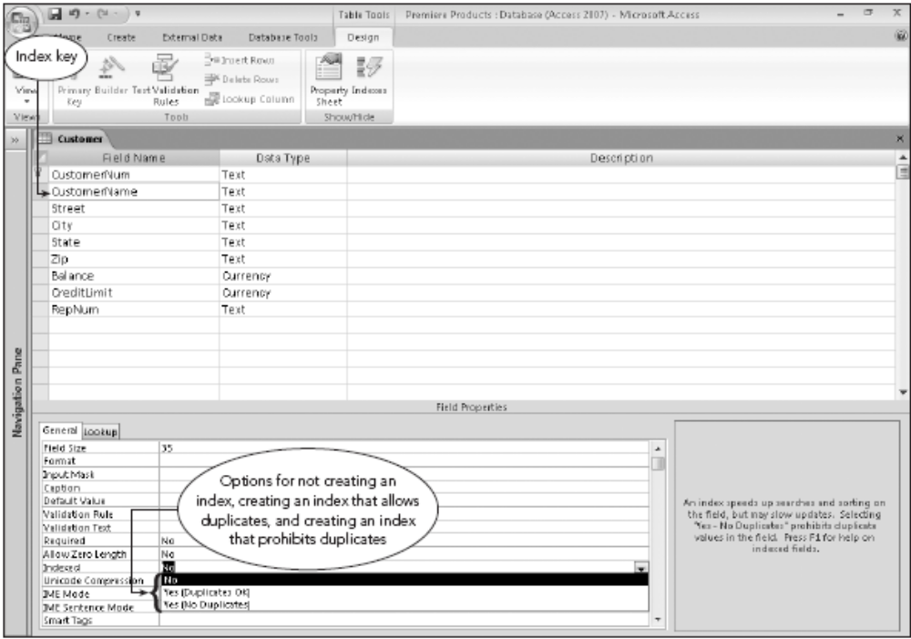
Indexes (continued)
FIGURE 4-13: Creating an index on a single field in Access
Concepts of Database Management

Slide 18
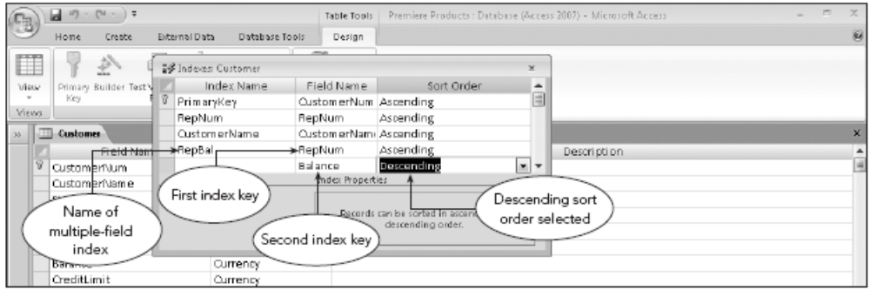
Indexes (continued)
FIGURE 4-14: Creating a multiple-field index in Access
Concepts of Database Management

Slide 19
Security
Prevention of unauthorized access to database
Database administrator determines types of access various users can have
SQL security mechanisms
  GRANT: provides privileges to users
    GRANT SELECT ON Customer TO Jones
    ;
  REVOKE: removes privileges from users
    REVOKE SELECT ON Customer FROM Jones
    ;
Concepts of Database Management

Slide 20
Integrity Rules
Two integrity rules must be enforced by a relational DBMS
  Integrity rules defined by Dr. E. F. Codd
  Entity integrity (Primary Key)
  Referential integrity – (PK -> FK)
Concepts of Database Management

Slide 21
Entity Integrity
No field that is part of primary key may accept null values
To specify primary key in SQL:
  Enter a PRIMARY KEY clause in either an ALTER TABLE or a CREATE TABLE command
To designate primary key in Access:
  Select primary key field in Table Design view
  Click the Primary Key button in the Tools group on the Table Tools Design tab
Concepts of Database Management

Slide 22
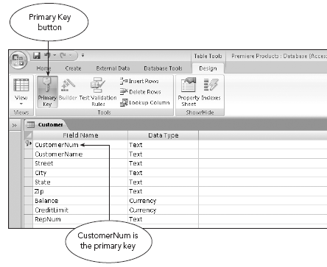
Entity Integrity (continued)
SQL command to specify a primary key:
  PRIMARY KEY (CustomerNum)
FIGURE 4-15: Specifying a primary key in Access
Concepts of Database Management

Slide 23
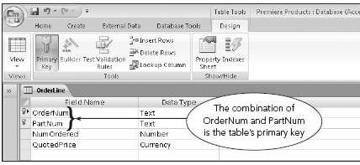
Entity Integrity (continued)
SQL command when more than one field included:
  PRIMARY KEY (OrderNum, PartNum)
FIGURE 4-16: Specifying a primary key consisting of more than one field in Access
Concepts of Database Management

Slide 24
Referential Integrity
Foreign key: field(s) whose value is required to match the value of the primary key for a second table
Referential integrity: if table A contains a foreign key that matches the primary key of table B, the values of this foreign key must match the value of the primary key for some row in table B or be null
To specify referential integrity in SQL:
  FOREIGN KEY clause in either the CREATE TABLE or ALTER TABLE commands
Concepts of Database Management

Slide 25
Referential Integrity (continued)
To specify a foreign key, must specify both:
  Field that is a foreign key
  Table whose primary key the field is to match
Example:
  FOREIGN KEY (RepNum) REFERENCES Rep(RepNum)
In Access, specify referential integrity while defining relationships
Concepts of Database Management

Slide 26
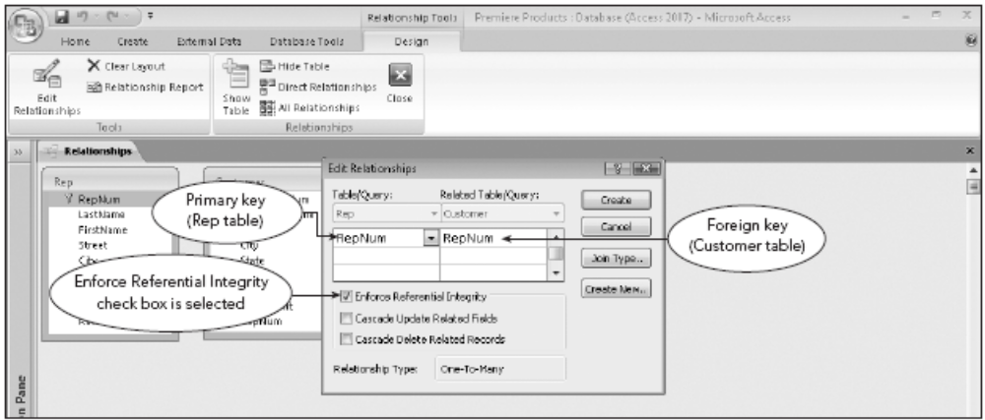
Referential Integrity (continued)
FIGURE 4-18: Specifying referential integrity in Access
Concepts of Database Management

Slide 27
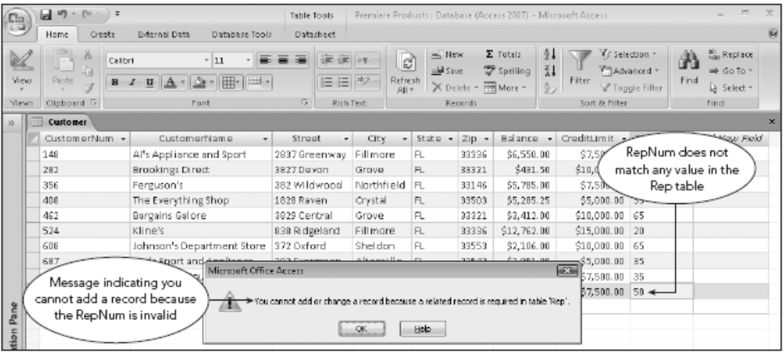
Referential Integrity (continued)
FIGURE 4-19: Referential integrity violation when attempting to add a record
Concepts of Database Management

Slide 28
Legal-Values Integrity
Legal values: set of values allowable in a field
Legal-values integrity: no record can exist with a value in the field other than one of the legal values
SQL
  CHECK clause enforces legal-values integrity
  Example:
  CHECK (CreditLimit IN (5000, 7500, 10000, 15000))
Concepts of Database Management

Slide 29
Legal-Values Integrity (continued)
Access
  Validation rule: must be followed by data entered
  Validation text: informs user of the reason for rejection of data that violates the rule
Concepts of Database Management

Slide 30
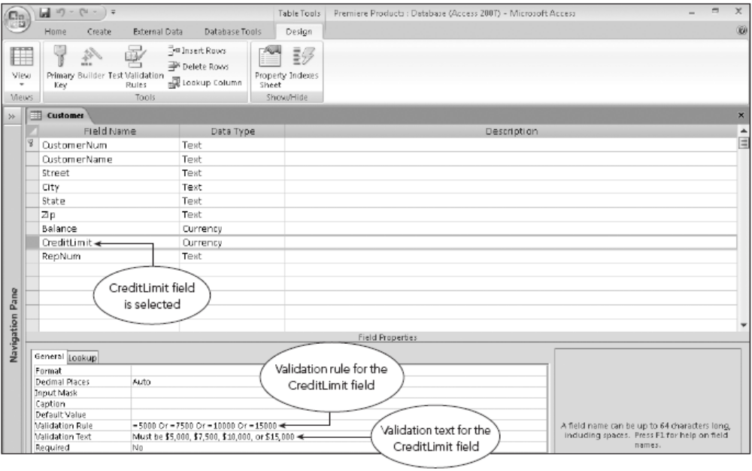
Legal-Values Integrity (continued)
FIGURE 4-21: Specifying a validation rule in Access
Concepts of Database Management

Slide 31
Structure Changes
Examples of changes to database structure
  Adding and removing tables and fields
  Changing characteristics of existing fields
  Creating and dropping indexes
SQL ALTER TABLE command changes table’s structure
To add a new field to the Customer table:
  ALTER TABLE Customer
  ADD CustType CHAR(1)
  ;
Concepts of Database Management

Slide 32
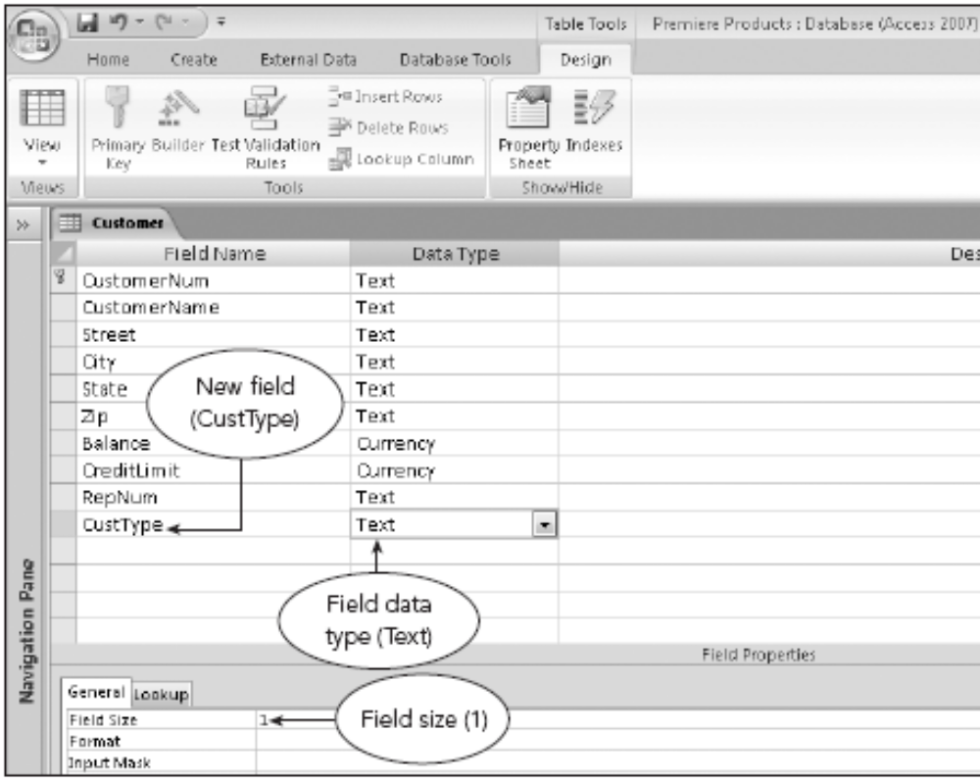
Structure Changes (continued)
FIGURE 4-22: Adding a field in Access
Concepts of Database Management

Slide 33
Structure Changes (continued)
Changing properties of existing fields
  ALTER TABLE Customer
  CHANGE COLUMN CustomerName TO CHAR(40)
  ;
Deleting a field from a table
  ALTER TABLE Part
  DELETE Warehouse
  ;
DROP TABLE command deletes a table
  DROP TABLE SmallCust
  ;
Concepts of Database Management

Slide 34
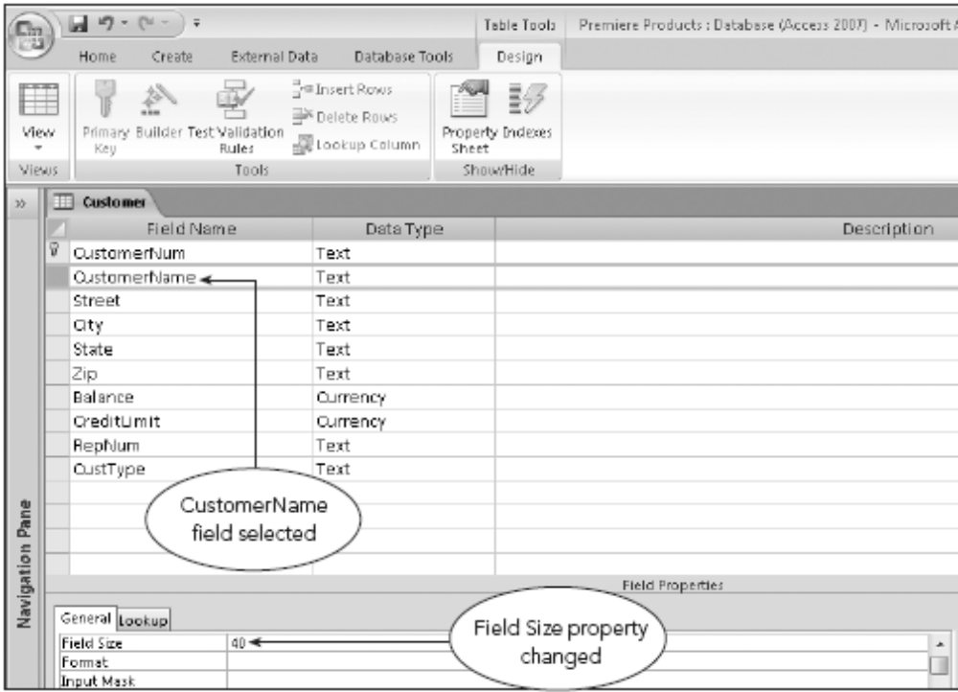
Structure Changes (continued)
FIGURE 4-23: Changing a field property in Access
Concepts of Database Management

Slide 35
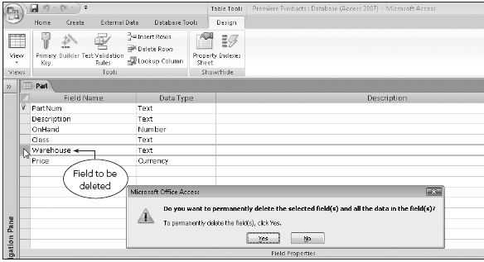
Structure Changes (continued)
FIGURE 4-24: Dialog box that opens when a field in Access is deleted
Concepts of Database Management

Slide 36
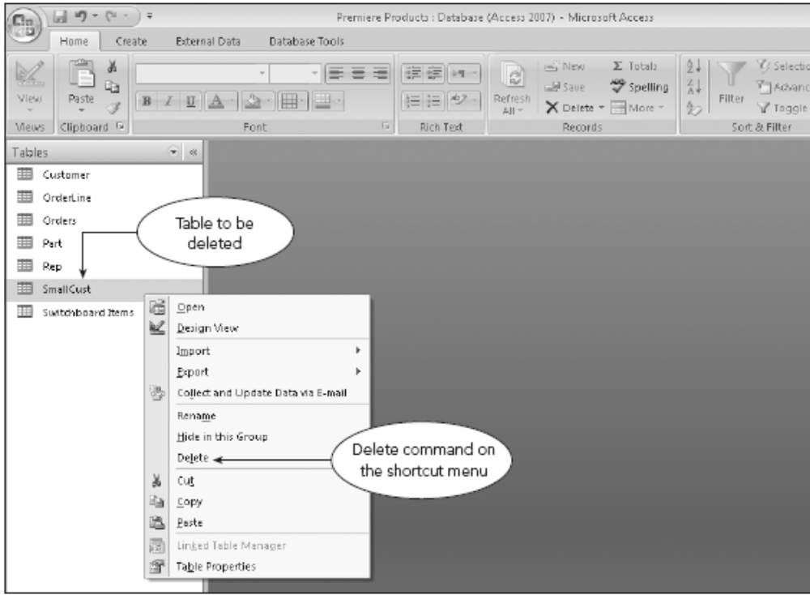
Structure Changes (continued)
FIGURE 4-25: Deleting a table in Access
Concepts of Database Management

Slide 37
Making Complex Changes
Some changes might not be allowed by your DBMS
In these situations, you can:
  Use CREATE TABLE command to describe the new table
  Insert values into it using INSERT command combined with a SELECT clause
SELECT INTO command can create the new table in a single operation
Concepts of Database Management

Slide 38
System Catalog
System catalog (or catalog)
  Contains information about tables in the database
  Maintained automatically by DBMS
Example catalog has two tables
  Systables: information about the tables known to SQL
  Syscolumns: information about the columns or fields within these tables
Concepts of Database Management

Slide 39
System Catalog (continued)
Other possible tables
  Sysindexes: information about indexes
  Sysviews: information about views
Catalog can be used to determine information about the structure of the database
Documenter: allows user to print detailed documentation about any table, query, report, form, or other object in the database
Concepts of Database Management

Slide 40
Stored Procedures
Client/server system
  Database resides on a computer called the server
  Users access database through clients
Client
  Computer connected to a network
  Has access through server to the database
Concepts of Database Management

Slide 41
Stored Procedures (continued)
Stored procedure
  Special file used to store a query that is run often
  Placed on the server
  Improves overall performance
  Convenience
Concepts of Database Management

Slide 42
Stored Procedures (continued)
MySQL
  Delimiter: semicolon at the end of a MySQL command
  Need to temporarily change the delimiter for a stored procedure
  To use a stored procedure: CALL followed by the procedure name
Access does not support stored procedures
Concepts of Database Management

Slide 43
Triggers
Action that occurs automatically in response to an associated database operation such as an INSERT, UPDATE, or DELETE command
Stored and compiled on the server
Need to temporarily change the delimiter
Access does not support triggers
Concepts of Database Management

Slide 44
Summary
Views give each user his or her own view of the data in a database
Indexes facilitate data retrieval from the database
Security is provided in SQL systems using the GRANT and REVOKE commands
Entity integrity: no field that is part of the primary key can accept null values
Referential integrity: value in any foreign key field must be null or must match an actual value in the primary key field of another table
Concepts of Database Management

Slide 45
Summary (continued)
Legal-values integrity: value entered in a field must be one of the legal values that satisfies some particular condition
ALTER TABLE command allows you to add fields to a table, delete fields, or change the characteristics of fields
In Access, change the structure of a table by making the changes in the table design
DROP TABLE command lets you delete a table from a database
Concepts of Database Management

Slide 46
Summary (continued)
In Access, delete a table by selecting the Delete command on the table’s shortcut menu in the Navigation Pane
System catalog stores information about the structure of a database
Stored procedure: query saved in a file that users can execute later
Trigger: action that occurs automatically in response to an associated database operation such as an INSERT, UPDATE, or DELETE
Concepts of Database Management

